Slide 1
a short introduction to Au’s Mentor scheme for scientific staff

Slide 2
For who?
Post docs, assistant professors and researchers at this level can be mentees
Associate professors and professors can be mentors
You can sign up if you want to
Or you can suggest others to sign up
NEXT DEADLINE FOR REGISTATION: OCTOBER 22, 2017

Slide 3
Purpose
"It is essential for Aarhus University to attract, cultivate and retain the best researchers."
(AU strategy 2013-2020)
The idea behind Empower Talent! is - as indicated by the title – to empower talent at AU. We aim to contribute to:
retain and develop talent
support diversity
an attractive work environment at Aarhus University.

Slide 4
Possible benefits for mentees
Mentees can get:
Feedback on your CV
Help to develop your academic profile
Guidance in strategic prioritizing (working hours/tasks, work/life balance etc.)
Clarification of competencies
Advice on how to strengthen your network
Advice on how to create an academic career

Slide 5
Possible benefits for mentors
Mentors can:
Get satisfaction in helping a talented young researcher developing his or her talent
Influence and strengthen the research and educational environment at AU
Get new perspectives
Strengthen his/her communication skills
Contribute to the generational change at AU

Slide 6
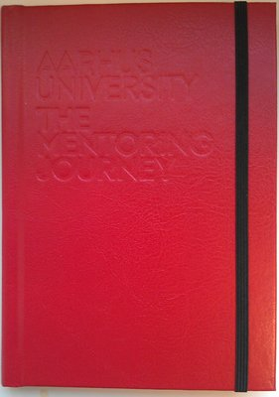
What is it?
Empower Talent! is basically a structure. You will be matched with a mentor/mentee based on the wishes you fill into the registration form. All couples are invited to a kick off meeting in order to support a good start. You also get a handbook with inspiration, advice and methods: “The mentoring journey”
We recommend a one year framework for your meetings.

Slide 7
And the price…
Participation is free of charge – the only price is the time you spend.
This decision is made based on research in mentor schemes and outcome.

Slide 8
QUoTES FROM mentees
“I have become more confident that I will pursue an academic career, and the potential for it has come closer.“
"Mentoring sessions have been a really good way to reflect on job-related dreams and goals, and I have taken some decisions in relation to prioritize tasks and plans.“
"My mentor has had - apart from his own experience from academia - a knowledge of talent and recruitment at the university."

Slide 9
QUoTES FROM mentors
100% of the first and second group of mentors and mentees will recommend Empower Talent! to colleagues ☺
"It is an advantage to be matched across departments and faculties. In that way mentoring sessions become something else than SDD and research supervision. It also helps to sweep away the myths about being so different“
"Seen from the perspective of the mentor it has been very interesting and given strength to the relationship to speak to someone from another faculty. I definitely recommend this.“

Slide 10
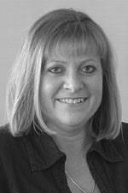
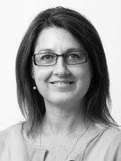
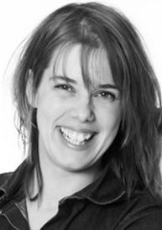
Learn more or register…
www.au.dk/empowertalent
If you have questions, please contact the project team:
Lizzi Edlich Charlotte Kirk Eva Damsgaard
lie@au.dk charlottekirk@au.dk edn@au.dk

