Slide 1
We are pioneers

Slide 2
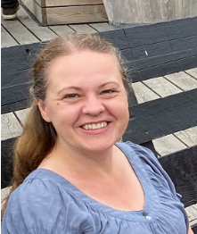
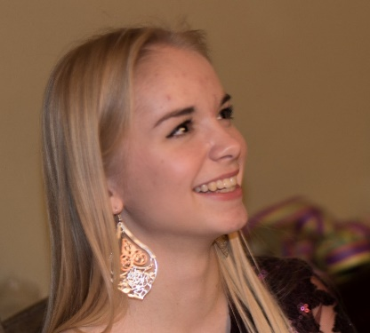
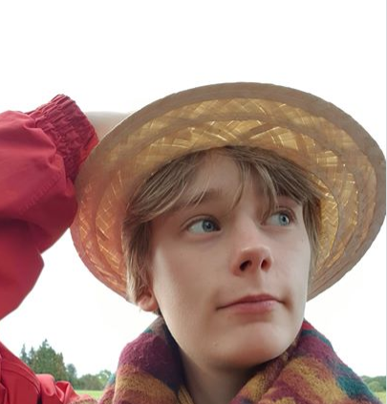
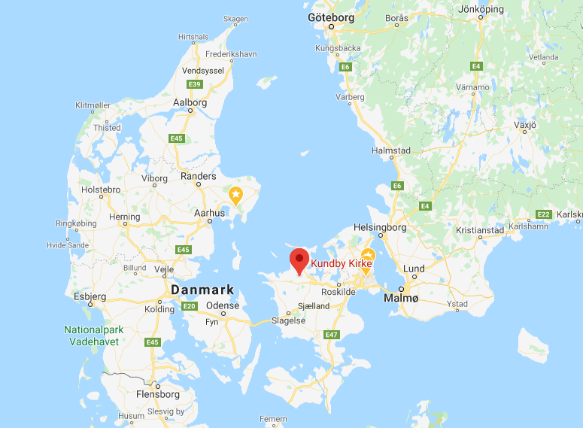
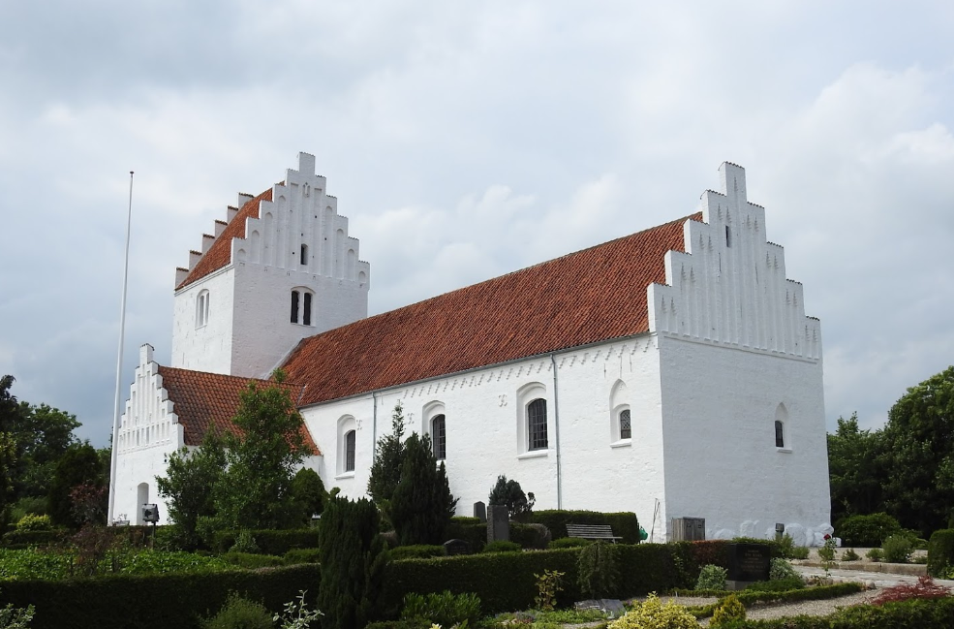
KP

Slide 3
Why should we have a faculty strategy?

Slide 4
You have already come far at the department!

Slide 5
The new nat can reach further with a common vision and strategy

Slide 6
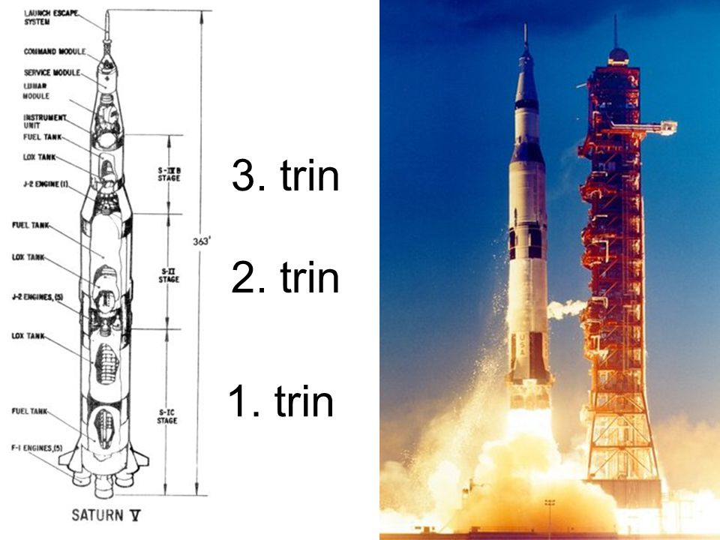
A three-stage rocket
Department strategy
--------------------------
Nat faculty strategy
--------------------------
University strategy

Slide 7
We have always been pioneers
2017: Open Science concept
2015: Public lectures in Natural Sciences begin livestream
2014: The Science Museums open
2017: Seven thematic centres open
2009: ”The rolling university”
2015: 12 active Centres of Excellence at Nat (DNRF)
2004: First ed. of the Magazine Aktuel Naturvidenskab
2004: Quarter structure at study programmes
2011-12: The Faculty of Science and Technology is created
2002: study internships for high school students
2002: iNANO
2002: Master´s Degree programmes in Engineering at Nat
2000: The IT city Katrinebjerg
1998: ASTRID
1992: The 4+4 ph.d. scheme is invented
1998: Dept. of Computer Science becomes independent from Mathematics
1991-1995: Nat is granted status as a ” free faculty”
1987: The Aarhus STM is built
1985: The Science Park INCUBA opens
1970´erne: Nat departments in one ”campus”
1968: Dept of Molecular Biology is established
1954: Nat is established (Physics, Chemistry, Geography + Mathematics)
-1954: Natural Sciences is a part of Medicine
1928
2020
2030

Slide 8


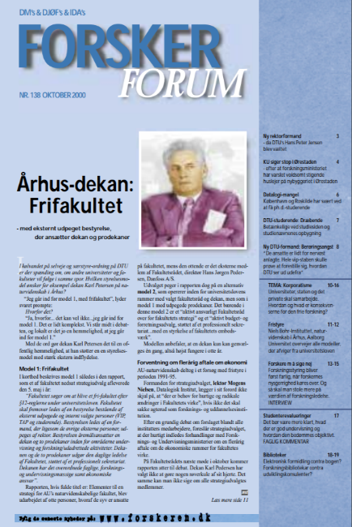
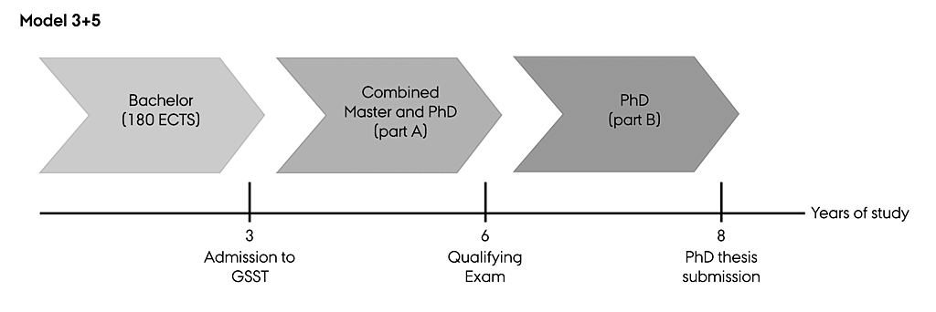
We have always been pioneers
??
2015: Public lectures in Natural Sciences begin livestream
2002: iNANO
1992: The 4+4 ph.d. scheme is invented
1991-1995: Nat is granted status as a ” free faculty”
1928
2020
2030

Slide 9
Nat is one of five faculties
Nat is today
1,431 employees
873 VIP
558 TAP
2,300 students
1,400,000,000 DKK in annual turnaround
NAT
23%

Slide 10
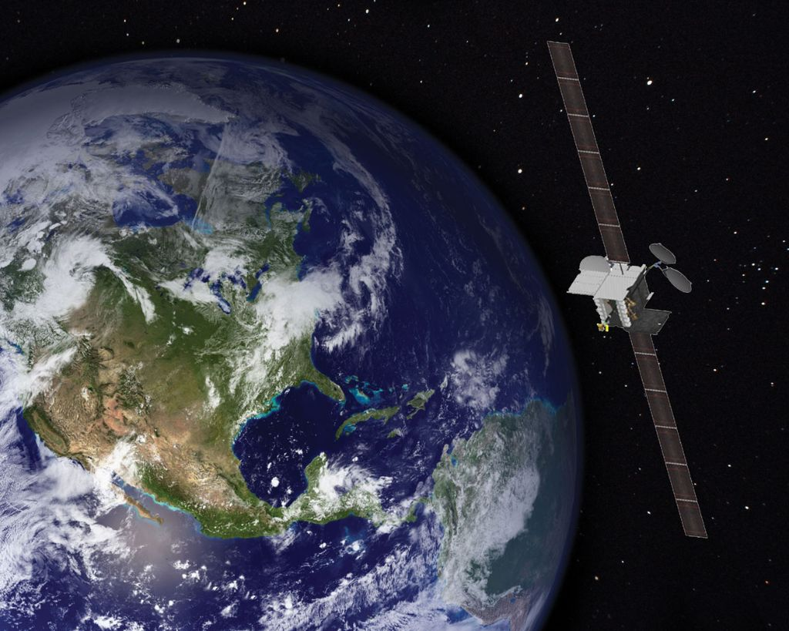
…we have to get up in the satellite!
…and measure ourselves on a global scale

Slide 11
The framework for the strategy
1) AU´s strategy
2) Our campus
The new Nat
3) My vision

Slide 12

1) The starting point is Au´s strategy
Notes:
Firstly
The board of Aarhus University adopted a new strategy earlier this year It can be summarized in this figure
The focus is on the three core activities - research, education and collaboration - and the relationships between them
There will annual action plans, which also include activities at the departments

Slide 13
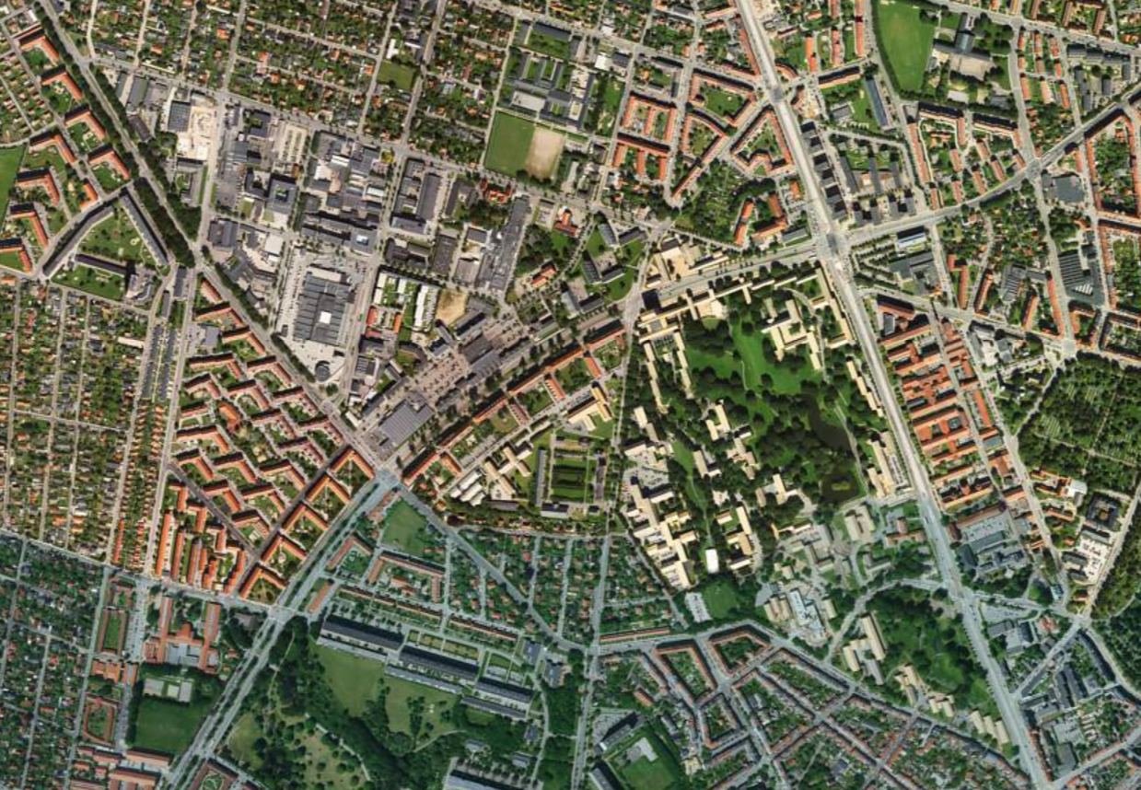
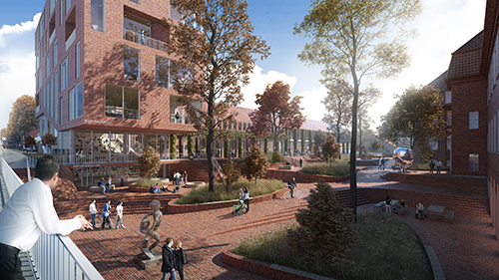
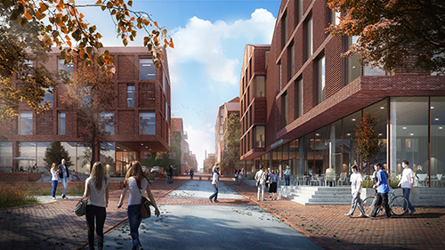
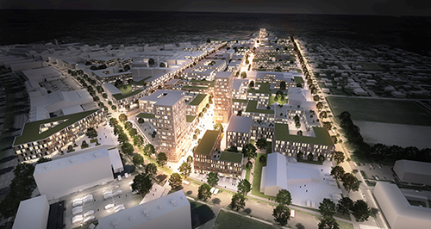
2) United on campus
Katrinebjerg: New campus for digital environments at Nat, Tech, and communication/
journalism at Arts
The University City:
Aarhus BSS
Molecular Biology and Genetics

Slide 14
3) My vision as dean
Pioneers
International
Excellence

Slide 15


A brief 10-year strategy
Long term
Common understanding of Nat:
Who are we? What distinguishes us?
~10 -year strategy with few strategic areas
Short term
1-year action plans at department and faculty level
Annual discussions and adjustment of action plans
Strategic area1
Strategic area 2
Strategic area 3
Nat Strategy
2020-2030

Slide 16
Plan for the strategy process
Research evaluations
Internal and external input
Follow up and analysis
Core narrative and strategy
2018-2019 November 2020 December 2020 January 2021
Internally
Self evaluation report | Workshops at departments & adm centre Focus groups with emplyees Academic Council and students | Collection of input Analysis & benchmarking | Consultation of core narrative Decision in Faculty Management Meetings
Eksternal inspiration
International external panels | Companies, alumni, foundations and high schools | Other universities
Output
Recommendations Implementation | Input from employees and stakeholders | Draft for core narrative | Core narrative Draft for strategy

Slide 17
We will do it together!

Slide 18
we are pioneers

