Slide 1
Lab User Meeting
01-04-25

Slide 2
Tell me if you lose a paper towel in the flow bench ☺

Slide 3
Chemical safety
Check up on the safety instructions for the chemicals you work with.
Please let me know when you receive anything (kits, chemicals, reagents) with a hazard label.
Send me any safety data sheets you get when ordering consumables.

Slide 4
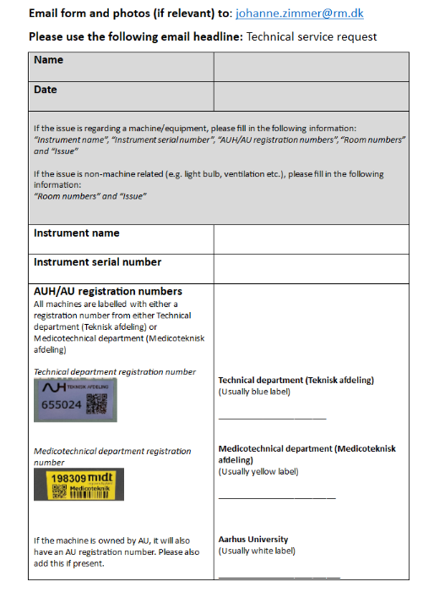
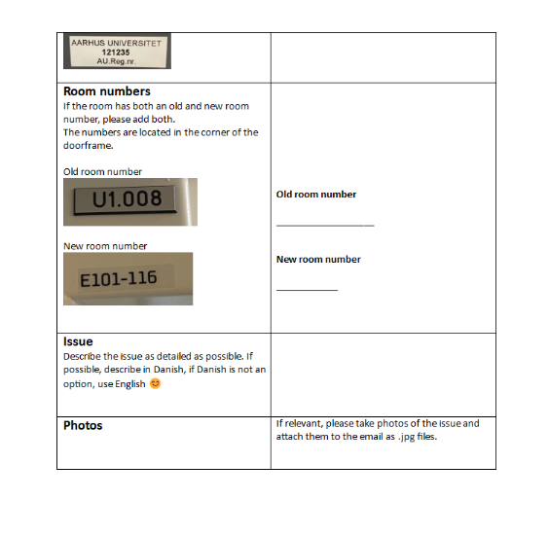
Technical service request form
Notes:
Please fill this out, when something isn’t working.
Equipment, lights in the hallway, ventilation etc. –Anything we can’t fix ourselves.

Slide 5
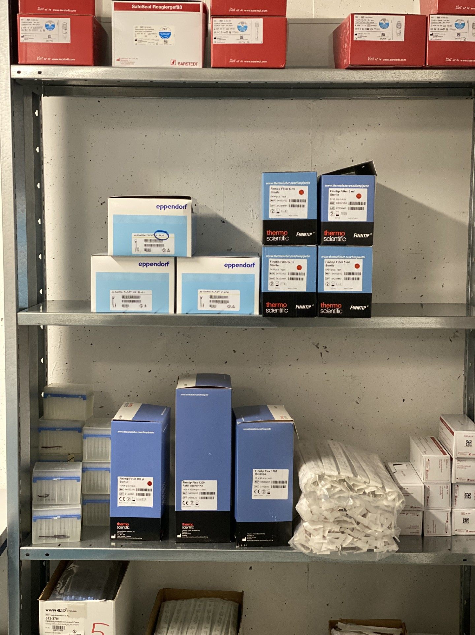
Stock of “old” pipette tips
Please use these first ☺
1000 & 1200 µL unsterile
0.5 (2) – 20 µL filter, sterile
300 µL filter, sterile
Check the shelves across from the cupboards

Slide 6
BSL III update
Both flow benches work – if you turn one on or off, the pressure needs to stabilise
We can’t autoclave waste at the moment, so please limit any activity in the lab, if you can.

Slide 7
Anything to add?
Notes:
Smell of chemical fumes in the Cell lab cupboard –please clean your racks and let any chemicals evaporate completely before placing them back in the cupboard.
The left flow bench in Cell lab is not connected to the exhaust, so please don’t use this as a fume hood.
Table centrifuges from primary cell lab will be moved to storage. Please tell Johanne, if you need them.

