Slide 1
Lab User Meeting
11-03-25

Slide 2
Lab safety
First aid kit in the lunchroom
Chemical spill kit in the chemical room
Who to call
Lesser injuries: your own doctor
Puncture wounds with a risk of HIV or hepatitis: the dept. doctor on duty
New poster with numbers will be on the door to the lunchroom
Emergency shower is in the main lab
Notes:
Two weeks ago, we had an accident with a puncture wound.
As a result, we could conclude that we have been lacking in the intro to lab safety and the accessibility of information in such a situation, therefore: this slide
If you need help assessing a situation, try to find/call some senior staff, Johanne, or Martin.
With puncture wounds, more often than not, you just need to update your tetanus shot.

Slide 3
What do we wear in the lab?
Wear your lab coat
Change it weekly
Wear short sleeves or push sleeves up to the elbows
Wear your clogs
Or other washable shoes you don’t wear outside the lab
Long hair should be tied up
Remove hand jewellery if you aren’t wearing gloves (Preferably don’t wear any)
Change your lab coat if you suspect contamination of any kind!
Notes:
Short sleeves (easy access to prober hand hygiene)
Lab coat closed over personal clothes
Long hair should be tied up
Shoes are seen as “unclean” and should be washable
Source: SSI
https://e-dok.rm.dk/edok/Admin/GUI.nsf/Desktop.html?open&openlink=http://e-dok.rm.dk/edok/enduser/portal.nsf/Main.html?open&unid=X906AA413DAF65E66C125750B0040655C&level=AAUH&dbpath=/edok/editor/RM.nsf/&windowwidth=1100&windowheight=600&windowtitle=S%F8g

Slide 4
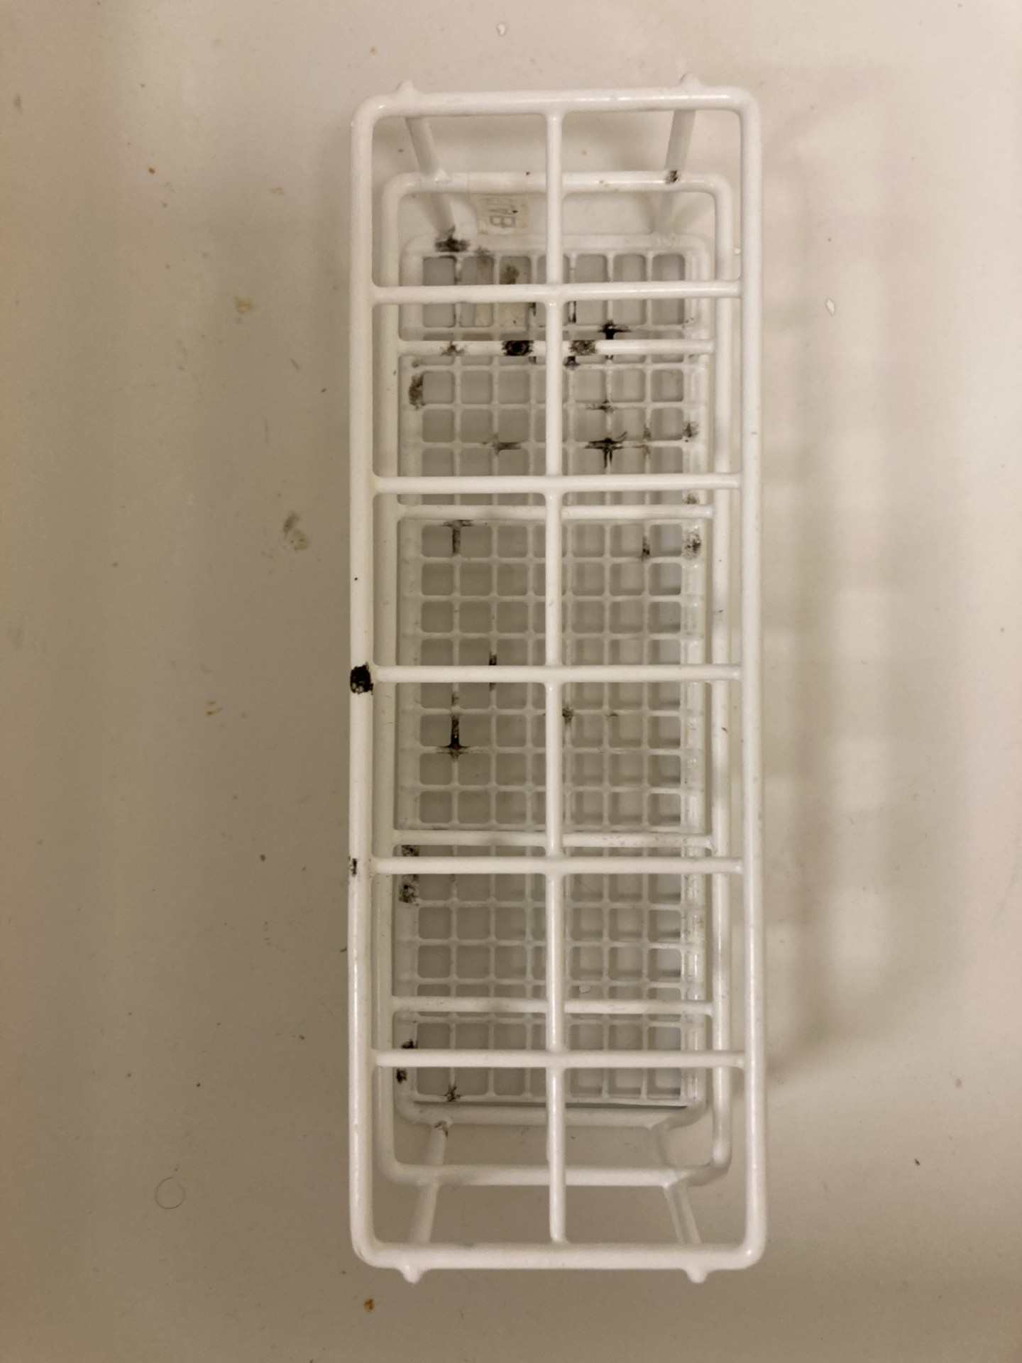
Mould in Cell lab
A rack covered in mould was found in cell lab
Notes:
A rack filled with black mould was found in cell lab 7/2-25.
Please remember to clean your tools and utensils properly! This was probably covered in media, when it was placed in the cupboard…
Place it in the “to be washed” basket, if you can’t clean it yourself (but please remember to collect in and place it back where it belongs)
New labels on the racks will hopefully make this easier ☺
And please remember to clean up and fill up utensils

Slide 5
Reminder
Don’t overfill the small yellow trashcans!
If you are unsure on how to sort the trash, please ask ☺

Slide 6
New cleaning groups
Lab cleaning is an important part of our work!
Ensures proper workflow
Keeps the machines/ centrifuges running – they last longer and breaks less
Ensures more reliable results!
As a group leader please arrange a meeting with you cleaning group this week or the next to ensure proper introduction and coordination <3
Please clean the fridges and freezers
Notes:
Tips on cleaning the fridges and freezers:
Use two rolling carts, one for the refrigerated stuff, one for the frozen. Place them in the walk-ins accordingly. Defrost the freezer when it’s empty by turning it off. Write an email to people asking them to move the stuff they are using from the carts to the fridge/freezer (give them a week), and throw the rest out.

Slide 7
Anything to add?
Notes:
The flow bench in GMO lab has an issue with the downflow, a technician has been scheduled.
The left flow bench in Cell lab is not connected to the exhaust, so please don’t use this as a fume hood.
Lower incubator in Cell lab is out of order, a technician is on the case.
Table centrifuges from primary cell lab will be moved to storage. Please tell Johanne, if you need them.

