Slide 1
Lab User Meeting
13-05-25

Slide 2
Good laboratory practice

Slide 3

What do we wear in the lab?
Wear your lab coat
  Change it weekly
Wear short sleeves, push sleeves up to the elbows or use disposable sleeves
Wear your clogs
  Or other washable shoes you don’t wear outside the lab
Long hair should be tied up
Remove hand jewellery if you aren’t wearing gloves
Change your lab coat if you suspect contamination of any kind!
Notes:
Lab coat closed over personal clothes
Long hair should be tied up
Shoes are seen as “unclean” and should be washable
Source: SSI
https://e-dok.rm.dk/edok/Admin/GUI.nsf/Desktop.html?open&openlink=http://e-dok.rm.dk/edok/enduser/portal.nsf/Main.html?open&unid=X906AA413DAF65E66C125750B0040655C&level=AAUH&dbpath=/edok/editor/RM.nsf/&windowwidth=1100&windowheight=600&windowtitle=S%F8g

Slide 4
Label your lab coat (and everything else)
Use a “pocket protector”, a piece of tape or a post-it in the pocket.
19 lab coats were found without a nametag during the easter break.
Generally: label everything… Lab coats, clogs, reagents, samples
  With name/initials, date + year!

Slide 5
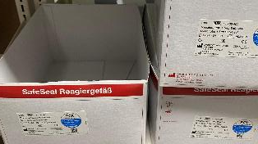
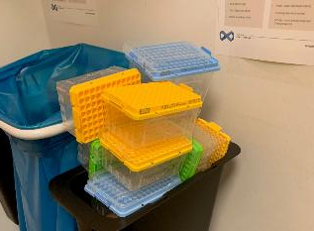
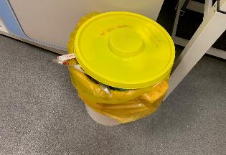
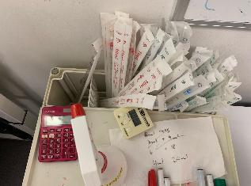
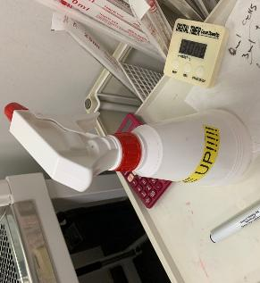
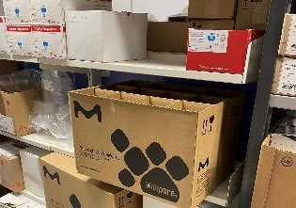
Cleaning and stocking up
It is everybody’s responsibility
Nobody should use the first 30 min. of their lab time cleaning up after somebody else.
And please remember to put the cover on the microscopes
Notes:
Pictures taken after Easter break in Cell lab and the storage room

Slide 6
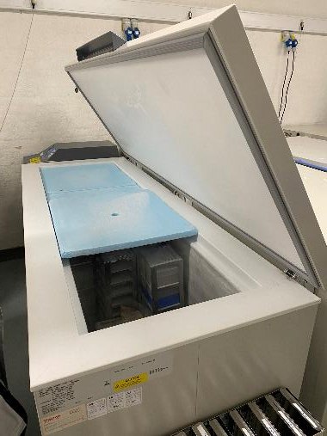
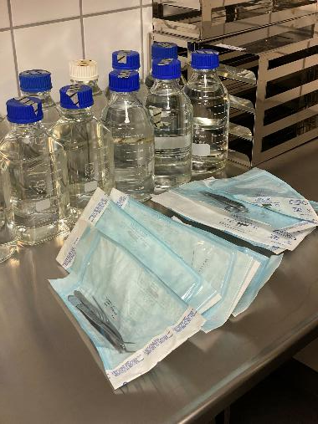
Freezers and the dishwash room
Notes:
Remember to place the styrofoam lids correctly, so you can close the freezer completely!
-And please tell Johanne if there is a lot of build-up ice in the freezers.
Collect your autoclaved utensils and what you’ve placed in the “to be washed” basket.

Slide 7
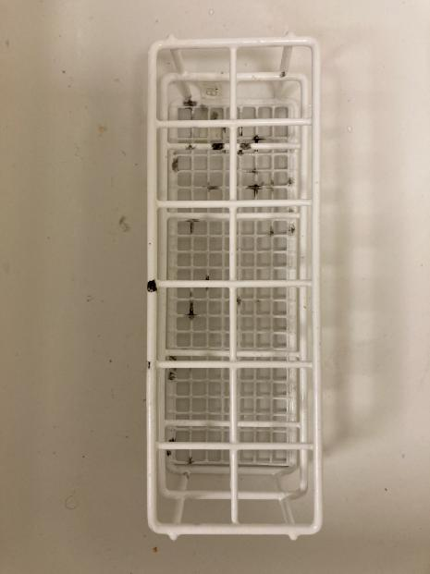
Mould in Cell lab
Clean your tools and instruments properly!
Notes:
A rack filled with black mould was found in cell lab 7/2-25.
Please remember to clean your tools and utensils properly! This was probably covered in media, when it was placed in the cupboard…
Place it in the “to be washed” basket, if you can’t clean it yourself (but please remember to collect in and place it back where it belongs)
New labels on the racks will hopefully make this easier ☺

Slide 8
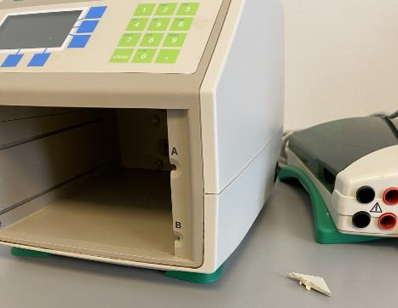
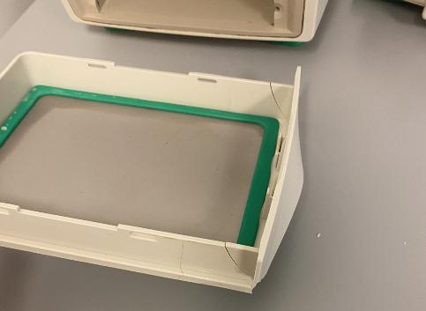
Gel lab
Please tell me if something breaks!
Remember to clean our equipment

Slide 9
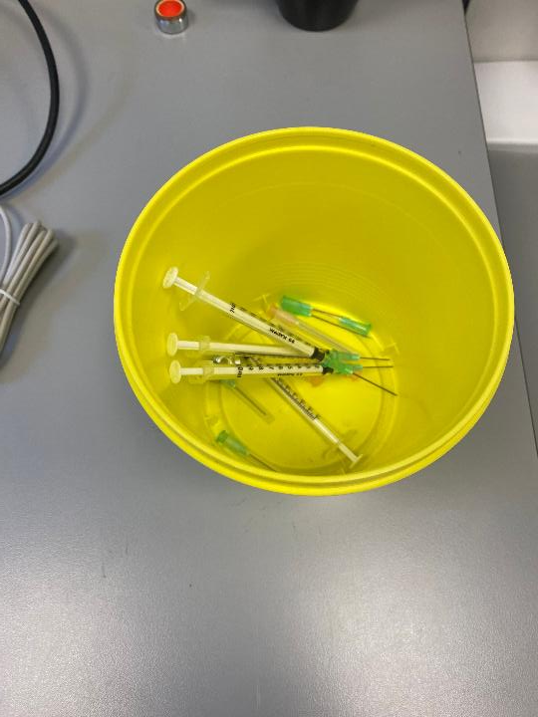
Needles
Please(!) do not reuse needles
Dispose of used needles in a yellow bucket with a lid
Notes:
Found in the windowsill in ELISA lab

Slide 10
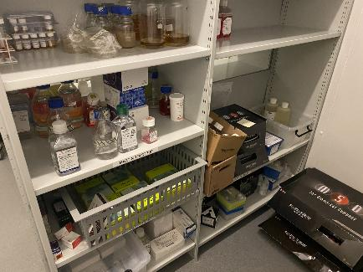
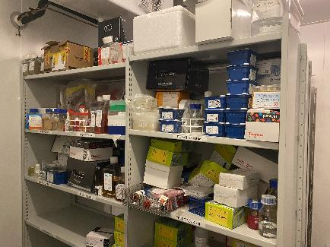
Cleaning tasks
Please clean the fridges and defrost the freezers in your cleaning area before summer!
Remember to clean and lubricate the centrifuges doing your weekly cleaning rotation.
There’s a lot of old stuff in the walk in. Please use 5 min to look around for any old stuff with your name on in.
Notes:
Tips on cleaning the fridges and freezers:
Use two rolling carts, one for the refrigerated stuff, one for the frozen. Place them in the walk-ins accordingly. Defrost the freezer when it’s empty by turning it off. Write an email to people asking them to move the stuff they are using from the carts to the fridge/freezer (give them a week) and throw the rest out.
I have found more than a little mould in the walk-in, so please(!) help me clean it out.

Slide 11
Clustermarket
Booking is not only for the sake of keeping the lab-space or equipment free, but also so we have a log of the users.
We need to know who to contact if something isn’t working or if we discover a fault that could potentially have affected your work.
Notes:
For instance: we don’t know how long the trans blot has been broken.

Slide 12
Subject change

Slide 13
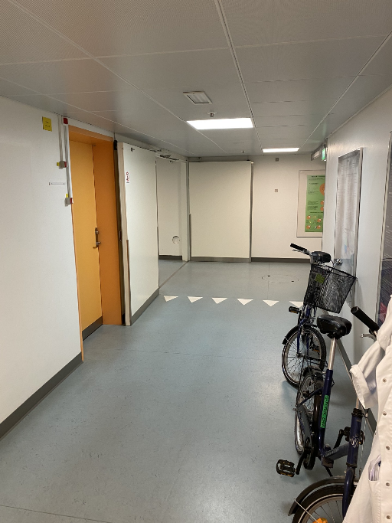
Fire safety
Orient yourself with the layout of the department and the locations of emergency exits, extinguishers, fire blankets, etc.
Keep the hallways free. Scooters, tables etc should only be on one side of the hallway -NEVER place them in front of a fire door or a fire hose.
Windowsills should be empty.

Slide 14
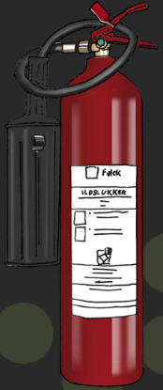

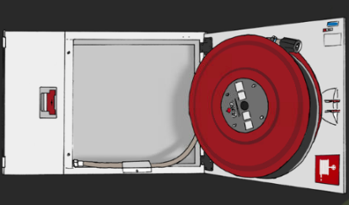
Fire hose:
Use on larger fires as it won’t run out of water
CO2 extinguisher:
Use on fires in flammable liquids, electrical equipment or gas.
Remember to turn of the power or gas supply.
Do NOT use on people
How to: Remove the split, aim, press down the handle and spread the CO2 on top of the flaming material
Fire blanket:
Use on smaller fires or on people
How to: Pull out the blanket by the strings. Remember to protect your hands and use it from the neck down on people
Notes:
Always:
Aim at the burning material, not at the flames
Do not risk your personal safety!
Press the alarm and call for help
Use what you’ve got on hand!

Slide 15
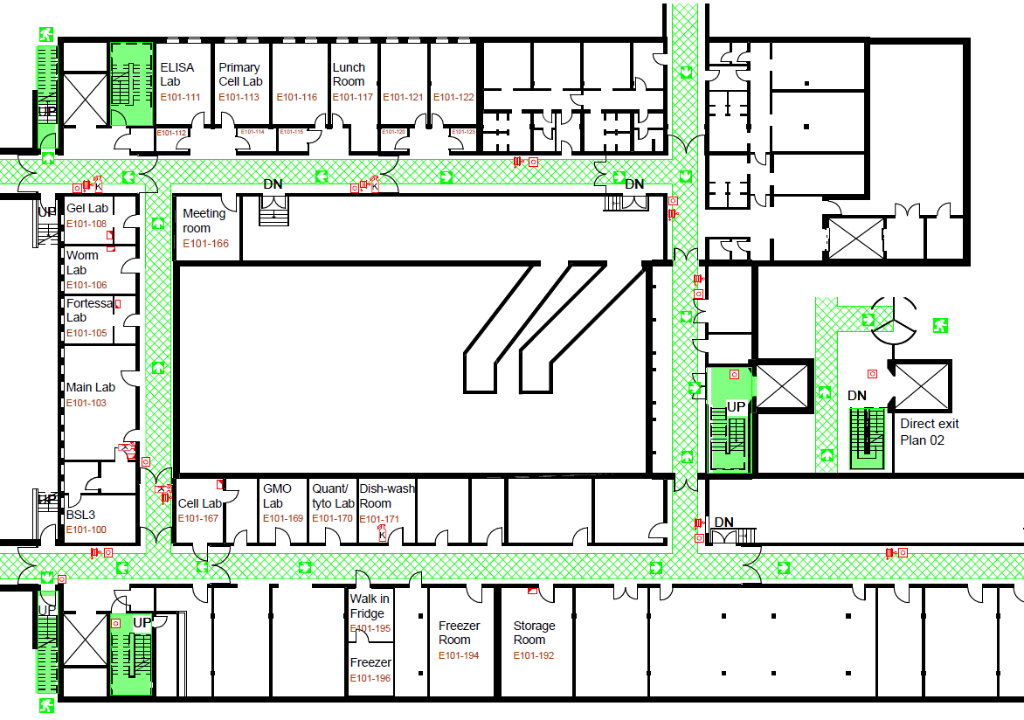
Notes:
The full map can be found on SharePoint

Slide 16
Guidelines for chemical spills
Can be found in the chemical room and on SharePoint
Remember to send me any new safety data sheet you receive ☺

Slide 17
Lab safety
First aid kit in the lunchroom
Chemical spill kit in the chemical room
Who to call
  Lesser injuries: your own doctor
  Puncture wounds with a risk of HIV or hepatitis: the dept. doctor on duty
  New poster with numbers is on the door to the lunchroom (and on SharePoint)
Emergency shower is in the main lab
Notes:
In February we had an accident with a puncture wound.
As a result, we could conclude that we have been lacking in the intro to lab safety and the accessibility of information in such a situation, therefore: this slide
If you need help assessing a situation, try to find/call some senior staff, Johanne, or Martin.
With puncture wounds, more often than not, you just need to update your tetanus shot.

Slide 18
Service info
Tomorrow 7-7.30: Emergency generator test, PCR labs
Table centrifuges from Primary Cell lab have been moved to storage. Please tell Johanne, if you need them.
The left flow bench in Cell lab is not connected to the exhaust, so please don’t use this as a fume hood.

Slide 19
Anything to add?

