Slide 1

bi0SpaCE, 20/03/2025
  —
    Data Management Plan (DMP)
      Fraunhofer IOSB, Gerd Sutschet

Slide 2
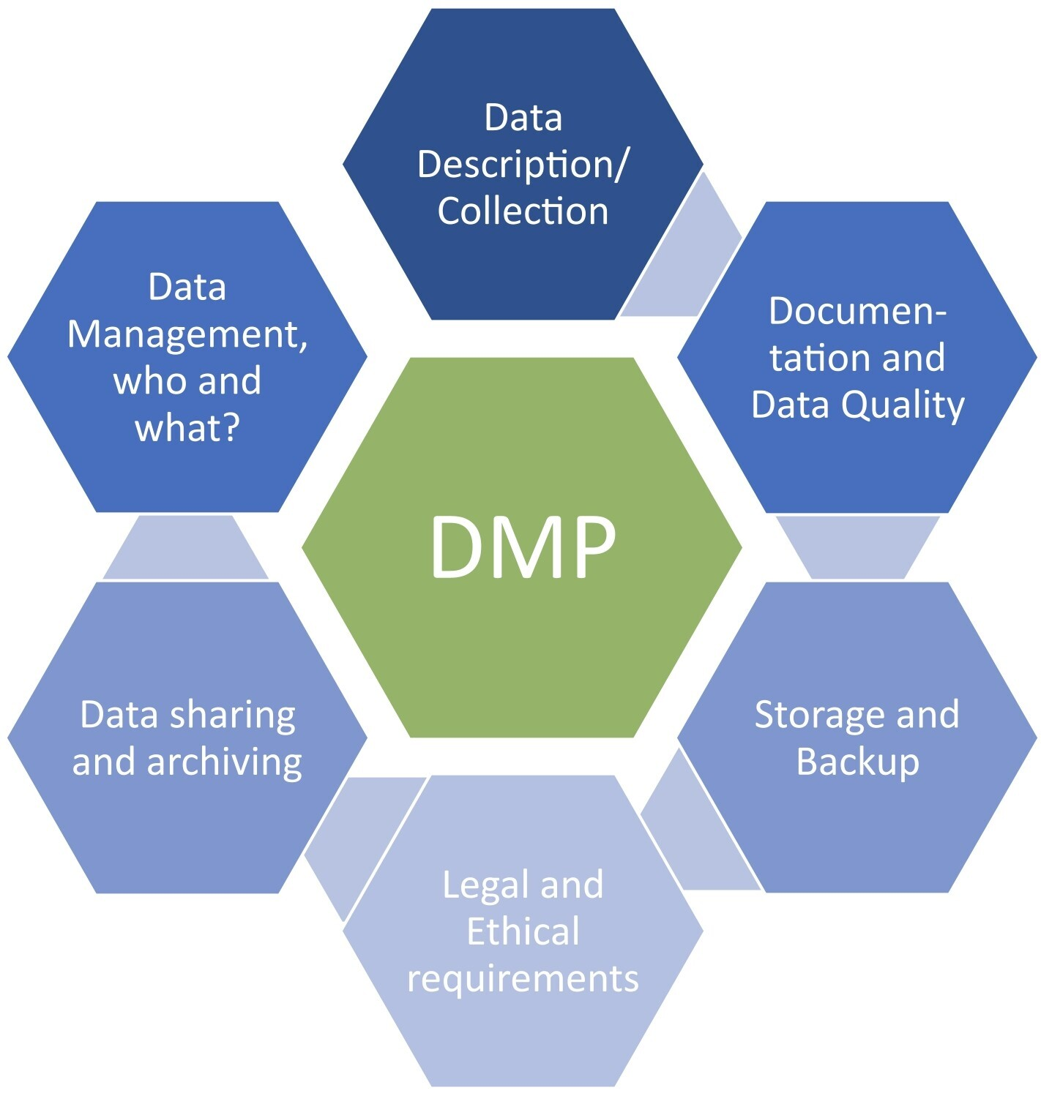
Data Management Plan (DMP)
Description:
      Since Horizon 2020 the DMP is a mandatory report for each project dealing with data and datasets.
      The DMP shall describe the data management life cycle for the data to be collected, processed and/or generated by a project.
      The aim is to make research data
        Findable
        Accessible
        Interoperable
        Re-usable
Responsibility:
  In bi0SpaCE Fraunhofer IOSB is responsible for technical/scientific coordination and DMP implementation. The work is done in WP1.2

Slide 3
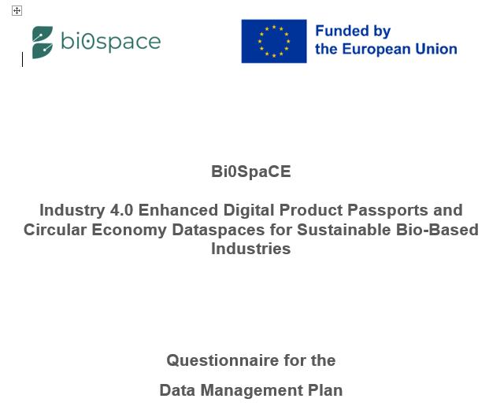
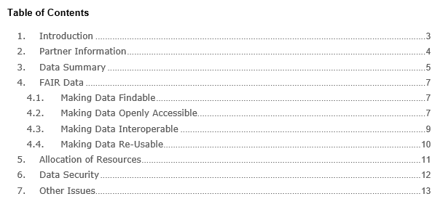
Content
Content of a DMP:
  A DMP shall contain information on:
      the handling of research data during & after the end of the project
      what data will be collected, processed and/or generated
      which methodology & standards will be applied
      whether data will be shared/made open access and
      how data will be curated & preserved
      (including after the end of the project).
      → Costs
    We tried to keep it as short as possible!

Slide 4
Timeline
Deliverables:
      The DMP is meant to be a living document. The initial version (v1) has to be updated during the entire project.
        D1.1 Data Management Plan (DMP) v1 due: M06
        D1.3 Data Management Plan (DMP) v3 due: M36
        D1.5 Data Management Plan (DMP) v2 due: M18
Timeline for D1.1 (initial DMP v1) due M06:
Steps
        Fraunhofer IOSB has set up a questionnaire for research data in bi0SpaCE
        Fraunhofer sends the questionnaire to each project partner
        Partners send back comments (errors, missing parts, unclear formulations, etc)
        Fraunhofer will circulate a consolidated version
        Coordinator chooses 2 internal reviewers
        1st draft of D1.1 to reviewers
        All partners send back the filled questionnaire
        2nd draft of D1.1 to reviewers
        Updated draft to WPL
        Final draft to coordinator
        Final Version of D1.1 to RSO/Bojana
Due
  done
  31/03/2025
  10/04/2025
  15/04/2025
  07/05/2025
  09/05/2025
  23/05/2025
  30/05/2025
  14/06/2025
  21/06/2025
  25/06/2025
Questionnaire to partners
Filled questionnaires back to Fraunhofer
D1.1 to RSO
Updated draft to WPL
Questionnaire draft
1st draft D1.1
2nd draft D1.1
Final draft
03
04
05
06

Slide 5
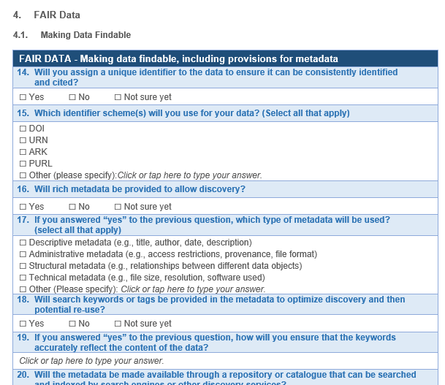
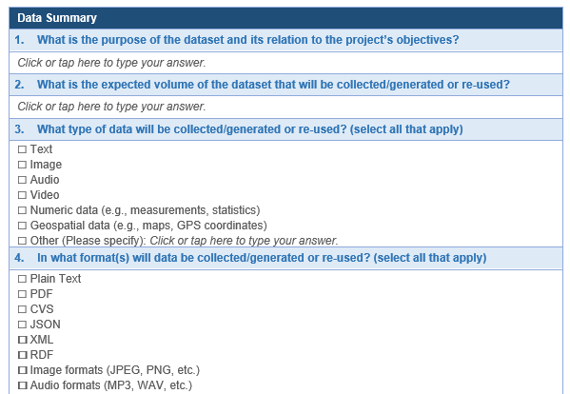
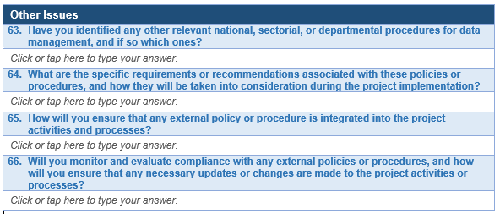
Questionaire

