Slide 1
Monthly Meeting
28th August 2025

Slide 2
T7.1 Communication, industrial and scientific dissemination

Slide 3
T7.1 Completed activities
Website updates
  Logo of the next coordinator included
  Contact form improved
    Improved form design
    Improved email routing - Emails will be sent to the coordinator
    Enhanced anti-spam measures
  Overall website optimization
3

Slide 4
T7.1 Preparation of 1st Newsletter
Proposed ToC for bi0SpaCE Newsletter #1
  Dear readers – NISSATECH
  PART I: The bi0SpaCE Approach
    High-Level Overview (FhG IOSB)
    Individual Components (DTU, AU, CARTIF, NISSATECH, FhG IOSB, SSF)
        A short description of the component
        Key research or technical challenges of the component
        A relevant figure or diagram
  PART II: bi0SpaCE Pilots
    For each pilot
      A short partner intro
      Use case description
      Expectations from bi0SpaCE
4

Slide 5
T7.1 Preparation of 1st Newsletter
Proposed ToC for bi0SpaCE Newsletter #1
  PART III: bi0SpaCE Status (First 9 Months)
    Summary of activities conducted (DTU)
    Collaboration with other projects (UNI)
    Planned workshop at SynergyDays 2025 (DTU)
  PART IV: Project Team Highlights & Acknowledgements (NISSATECH)
    Logos of all consortium partners
    A photo from the physical kick-off in Aarhus
    Acknowledgements:
    Further information
5

Slide 6
T7.1 Preparation of 1st Newsletter
  Next Steps & Timeline
  Content collection - All consortium partner should submit their contributions (text, figures, etc.) by 15 September 2025
  Editorial draft - NISSATECH prepares a full "ready-for-review" version of the newsletter including layout, images, etc. by 20 September 2025
  Internal review - The coordinator conducts a final internal review to ensure consistency, tone, and readiness by 25 September 2025
  Publishing & outreach (immediately following internal approval)
    NISSATECH: Website Post, LinkedIn Post:, Email to Subscribers
    UNI: Reach out to sister projects or relevant EU initiatives
    All partners: Distribute within networks & invite to subscribe
6

Slide 7
T7.1 Next Steps
Contributions by 15.09.2025
Ready for review version on 20.09.25
Internal review by the coordinator by 25.09.25
Awareness creation
  NISSATECH: a news on Webpage, a LinkedIn post, sending the newsletter to registered partners
  All partners: Inform partners in your network to register for newsletter or send us a list of potential interested parties that we can contact
  UNI: Inform “sister” projects or other relevant projects
7

Slide 8
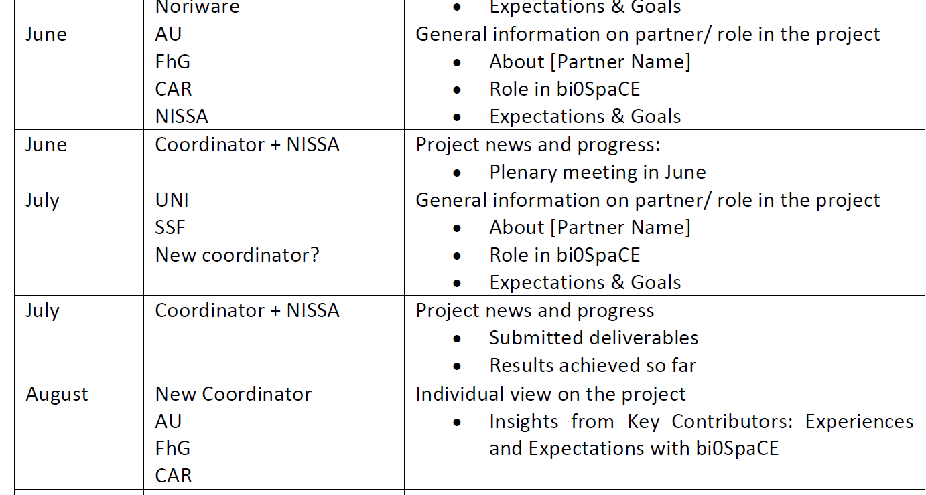
T7.1 Risks
Risk #1: Delayed partner contributions for LinkedIn, News, etc.
Mitigation plan:
  Set clear internal deadlines
  Send reminders
  Plan for contingencies
8

Slide 9
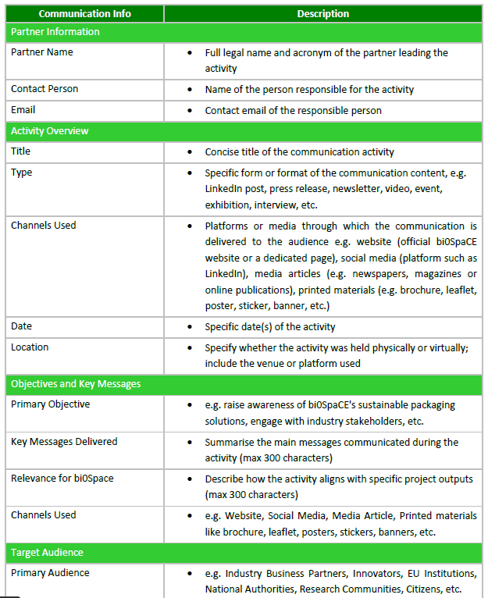
T7.1 Risks
Risk #2: No use of communication & dissemination templates
Mitigation plan:
  Monitor template use in monthly meetings (as not all partners participate in WP7 meetings)
  Reinforce the importance of early compilation of the templates
9

Slide 10
Plan for utilization of historical data and installation of sensors in pilot companies

Slide 11
T2.6: bi0SpaCE data collection framework: Historical data
T2.6: bi0SpaCE data collection framework (Leader: NISSA; Contributors: AU, CAR, FSK, GLB, NAT, ISP) [M7-M15]
The D2Port service will be used for hosting historical datasets
  Strict access control has been put in place
The D2Port service instance is currently configured to be used only for the bi0SpaCE project
Exported files (e.g. CSV) should be uploaded to the designated folder
  Partners will be provided with a link to upload the files
If needed, real-time data streams will be integrated via a message broker
  Meetings will be organized to clarify integration issues (e.g. topics)
If necessary, the data will be preprocessed
All datasets referenced in DMP 1.0 must be included
11

Slide 12
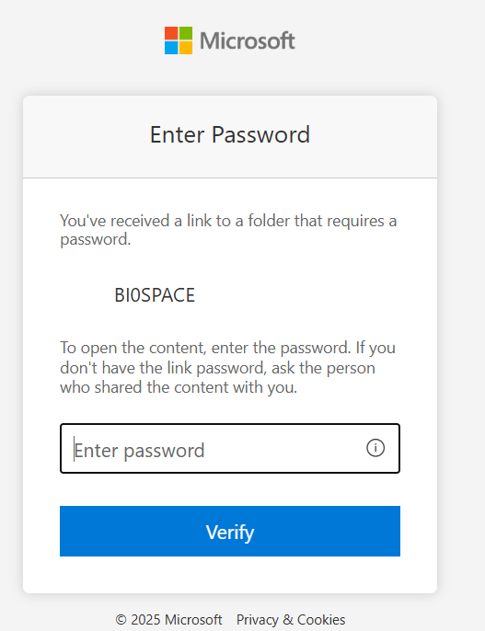
T2.6: bi0SpaCE data collection framework: Historical data
T2.6: bi0SpaCE data collection framework (Leader: NISSA; Contributors: AU, CAR, FSK, GLB, NAT, ISP) [M7-M15]
Exported files (e.g. CSV) should be uploaded to the designated folder
PROCEDURE
  Use the link:
    https://nissatechicdoo-my.sharepoint.com/:f:/g/personal/milan_vuckovic_nissatech_com/EuB_SMQYyj9Lojn-pvKXwScB_ElKc5S9VfoSMHTyyKC9AA?e=fyBtOP
  Enter password
  Upload files
12

Slide 13
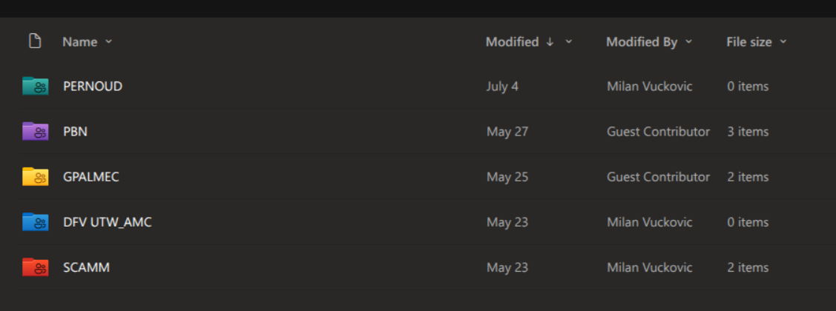
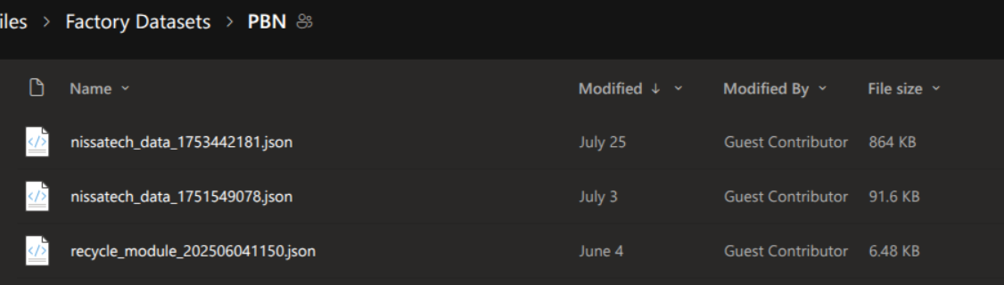
T2.6: bi0SpaCE data collection framework: Historical data
Example
13

Slide 14
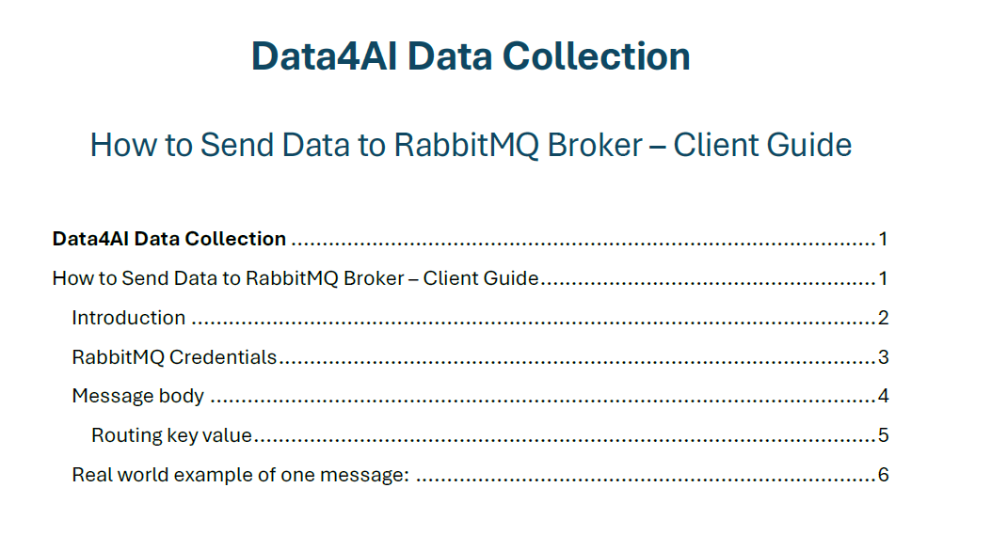
T2.6: bi0SpaCE data collection framework: Historical data
T2.6: bi0SpaCE data collection framework (Leader: NISSA; Contributors: AU, CAR, FSK, GLB, NAT, ISP) [M7-M15]
Real-time data streams will be integrated via a message broker
PROCEDURE
  Prepare data
  Send message to the Broker
  ALL IS DETAILED IN THE USER GUIDE
14

Slide 15
T2.6: bi0SpaCE data collection framework: Risks
Risk: Datasets referenced in DMP 1.0 might be partially uploaded, mislabeled, or inconsistent, hindering effective use
Mitigation: Provide clear metadata documentation and naming conventions for all uploads
Risk: Integrating real-time data via message brokers can introduce data loss especially if misconfigured
Mitigation: Include error-handling processes, such as retry mechanisms, dead-letter queues, and monitoring of message backlogs

Slide 16
Installation of sensors in pilot companies
Decision on sensors types

Slide 17
Installation of sensors in pilot companies
Risk: Delayed purchasing of sensors
Mitigation: Initiate procurement as early as possible
Risk: Sensor hardware and data formats may not be compatible with the future bi0SpaCE system
Mitigation: Select sensors supporting standard communication protocols (e.g., MQTT, OPC UA)

