Slide 1
Monthly Meeting
19th February 2026

Slide 2
T2.6: bi0SpaCE data collection framework: Historical data
T2.6: bi0SpaCE data collection framework (Leader: NISSA; Contributors: AU, CAR, FSK, GLB, NAT, ISP) [M7-M15]
Status of updated data
Status of contributions for D2.3
Risks
2

Slide 3
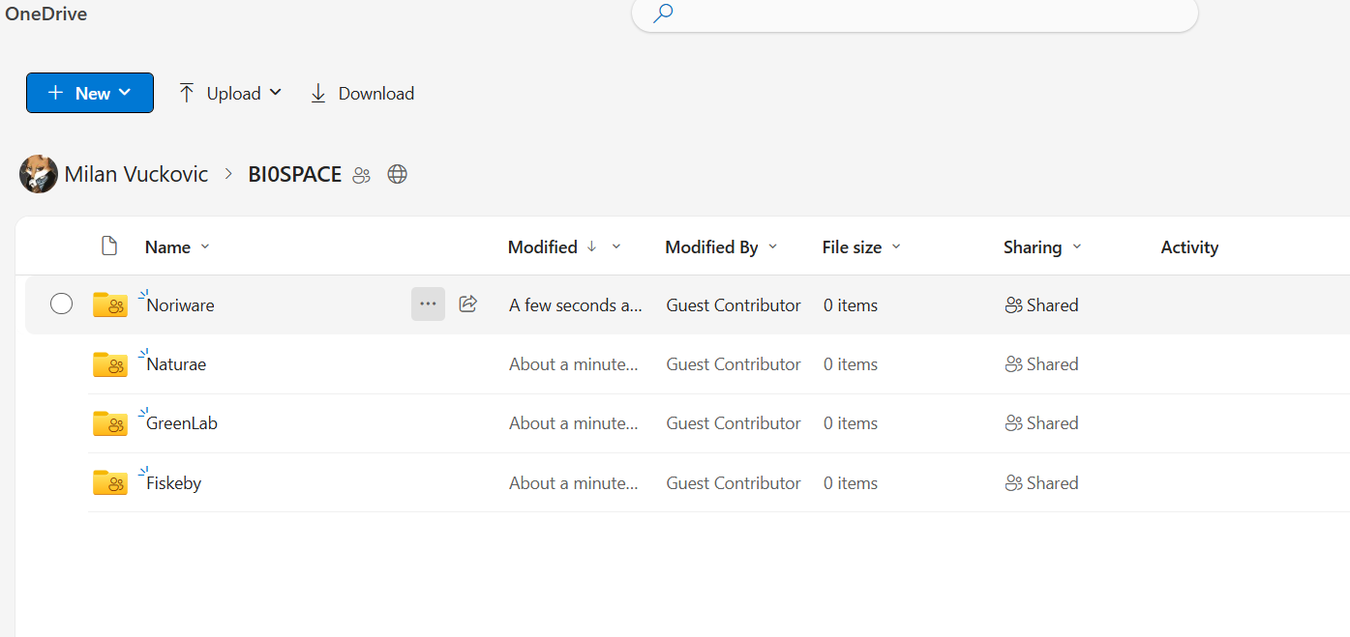
T2.6
Shared folder
All pilots provided data
  Do we need Datasets referenced in DMP 1.0?
For two, dataset explanation is missing

Slide 4
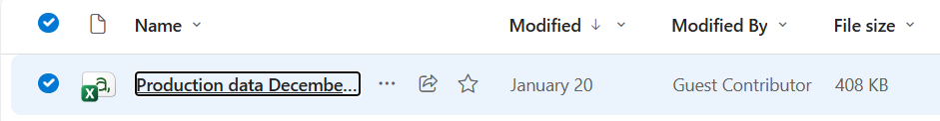
T2.6
Shared folder
Explanation is missing

Slide 5
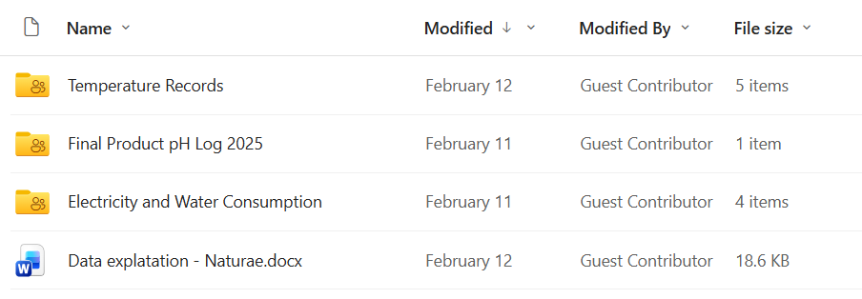
T2.6
Shared folder

Slide 6
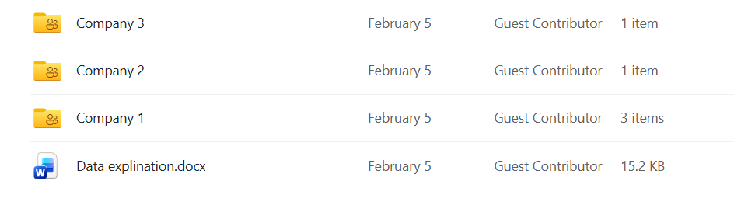
T2.6
Shared folder

Slide 7
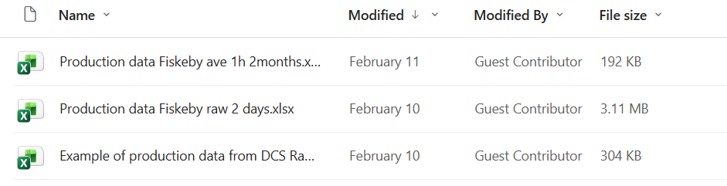
T2.6
Shared folder
Explanation of the datasets is missing

Slide 8
D2.3 Section 3
D2.3 input is missing!!!
Pilot should provide the draft input at earliest convenience
Use template: D2.3TemplateCollectingPastData.docx

Slide 9
T2.6: bi0SpaCE data collection framework: Risks
Risk: Datasets might be partially uploaded, mislabeled, or inconsistent, hindering effective use
Mitigation: Provide clear metadata documentation and naming conventions for all uploads
(related to the upload of data using message broker)
Risk: Integrating real-time data via message brokers can introduce data loss especially if misconfigured
Mitigation: Include error-handling processes, such as retry mechanisms, dead-letter queues, and monitoring of message backlogs

Slide 10
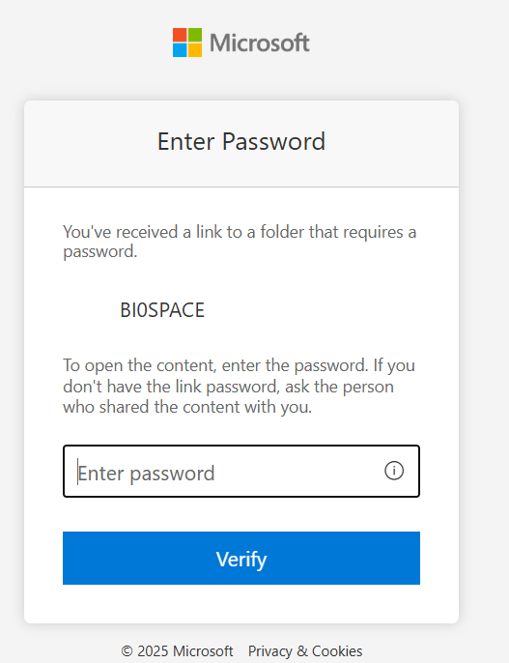
T2.6: bi0SpaCE data collection framework: Historical data
HOW TO UPLOAD THE DATASETS
Exported files (e.g. CSV) should be uploaded to the designated folder
PROCEDURE
  Use the link:
    https://nissatechicdoo-my.sharepoint.com/:f:/g/personal/milan_vuckovic_nissatech_com/EuB_SMQYyj9Lojn-pvKXwScB_ElKc5S9VfoSMHTyyKC9AA?e=fyBtOP
  Enter password
    pass: bi0space_datasets
  Upload files
10

