Slide 1
WP 3 / Task 3.1 NISSA

Slide 2
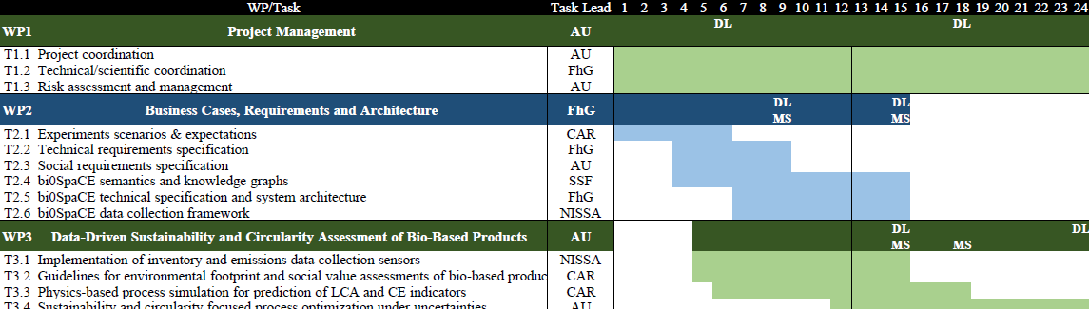
T3.1 Update, next steps and risks
Leader: Nissatech
Participants: pilots
Task start: M5
Task end: M15 (D3.1)
Now

Slide 3
Task 3.1: Implementation of inventory and emissions data collection sensors
T3.1 Implementation of inventory and emissions data collection sensors (Lead: NISSA; Participants: All) [M5 – M15]
This task will deliver the sensor infrastructure for the measurement of process inventory data (e.g., energy, water), operating conditions (e.g., pH, dissolved oxygen), and emissions (e.g., dissolved effluents in process water, biowaste) for the four bi0SpaCE pilots. This enables continuous tracking of process resource flows and exchanges for building online LCA and CE assessment models of bio-based processes, as well as developing causal, data-driven models for improving process performance. Data requirements for generating process life-cycle inventory models will be assessed, and a preliminary inventory for the LCA based on the data collection framework in T2.5.
Current data aggregation, process information already captured, data collection infrastructure and communication protocols, data gaps, will be benchmarked for each pilot, including existing historical data.
Each pilot partner will generate and deploy specific plans for implementing the required sensing systems.
Sensor installation and testing will occur at the pilot facilities, and data quality for DT generation will be validated. (Deliverable 3.1 in M15)

Slide 4
Deliverable 3.1 Technical documentation on sensor implementation and data pipe-lines
Description:
Data requirements for generating life-cycle inventories, data aggregation process, data collection infrastructure, communication protocols, and the identified data gaps for the four bi0SpaCE pilots. Report on sensor implementation, including technical specifications for the sensors and preliminary validation of data collection pipelines. The above results are based on work conducted in Task 3.1.
Authors: all pilots and their technical supporters
Deadline: 31.3.

Slide 5
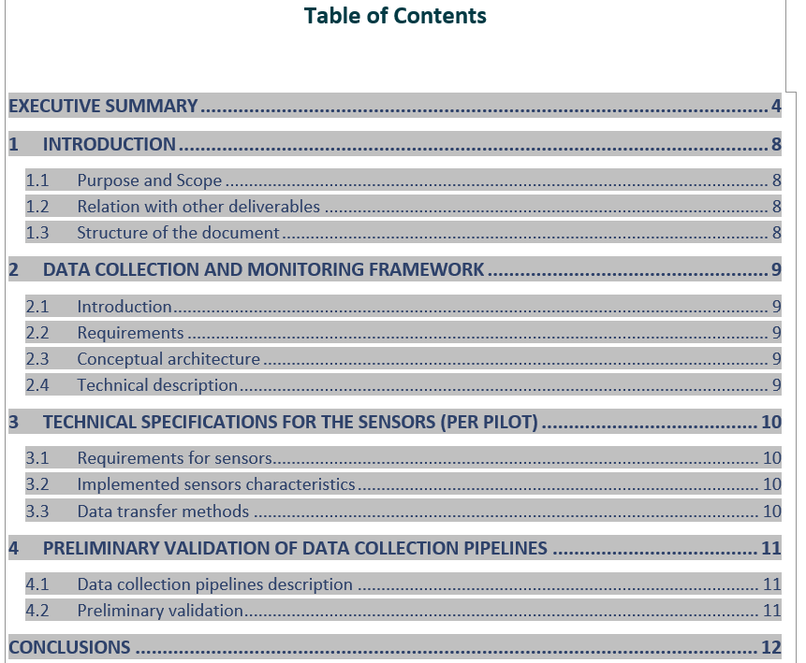
Deliverable 3.1 ToC
bi0SpaCE_D3.1Deliverable template.docx
On-line document:
bi0SpaCE_D3.1Deliverable template.docx
IMPORTANT: Section 3 – input from pilot
Timeline:
Initial input (Section 3.1) – end of January
Sections 3.2/3.3 – end of February
Refinement – mid of March
Review – ten days before the deadline
Only Naturae provided Section 3.1
All other inputs are missing
Notes:
bi0SpaCE_D3.1Deliverable template.docx

Slide 6
Installation of sensors in pilot companies
Risk: Delayed purchasing of sensors
Mitigation: Initiate procurement as early as possible
Risk: Sensor hardware and data formats may not be compatible with the future bi0SpaCE system
Mitigation: Select sensors supporting standard communication protocols (e.g., MQTT, OPC UA)

Slide 7

Architecture
message broker
SENSOR 5.0
D2Port
Data OBSERVATION
Data preparation
Data preparation
Data cleaning
Data cleaning
Data completeness
Data synchronization
Edge device
Data connectivity
wireless
PLC
wired
sensors
Machine/Asset
machine

Slide 8
THANKS

